Slide 1
30 May Meeting

Slide 2
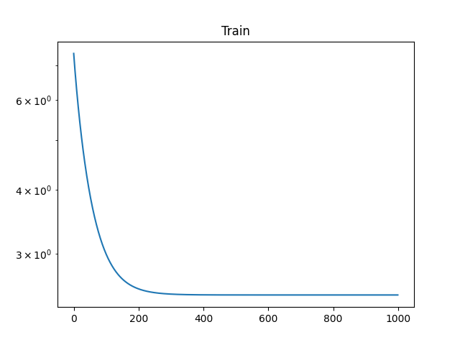
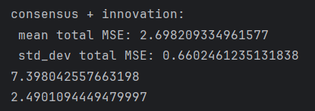
Learning rate = 0.01
Got stuck at local minimizer

Slide 3
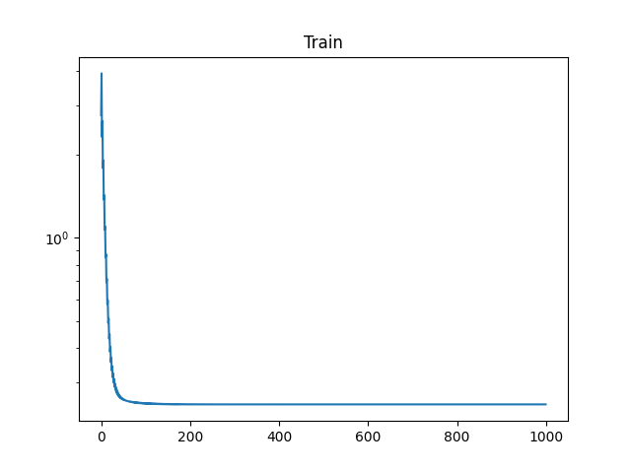
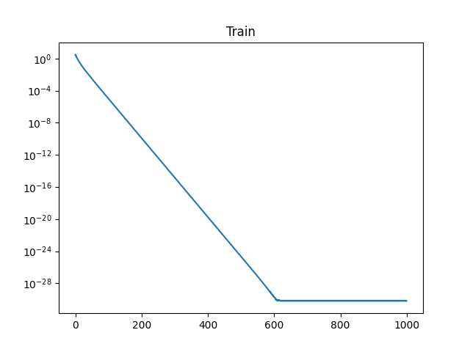


lr=0.11, various nodes per block
100 nodes per block
10 nodes per block

Slide 4
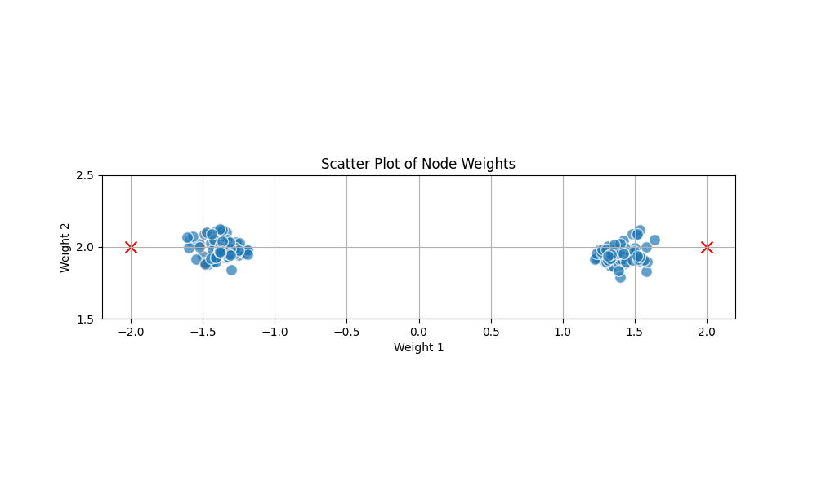
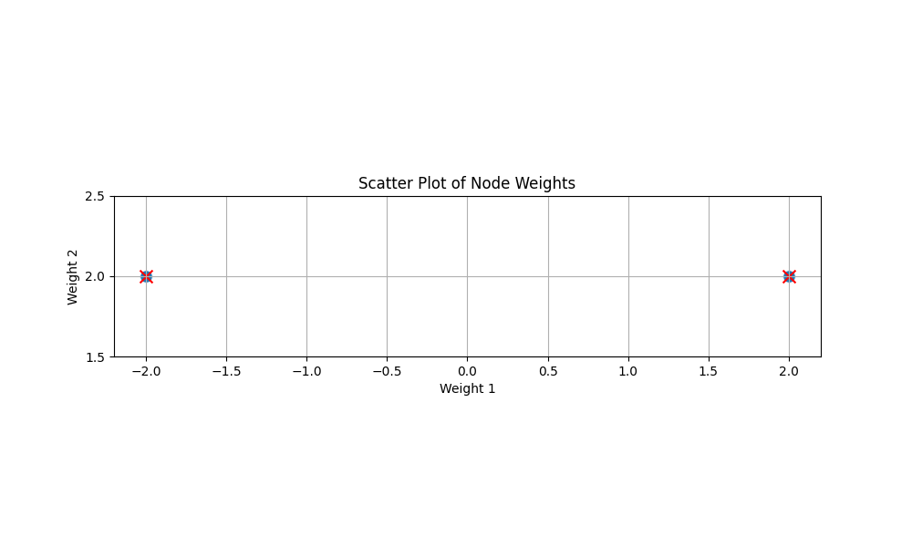
Weights Visualisation
100 nodes per block
First feature is not quite fit the desired weight
Second feature is around 2
10 nodes per block
Both features fit perfectly

Slide 5
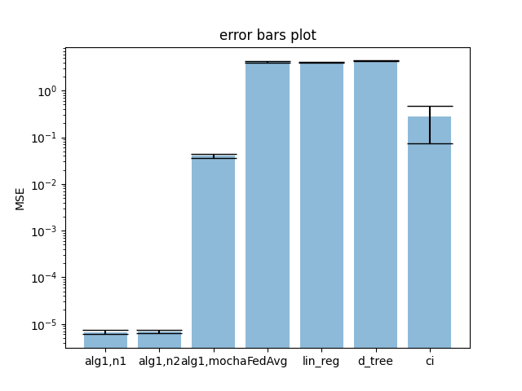
Bar plot

Slide 6
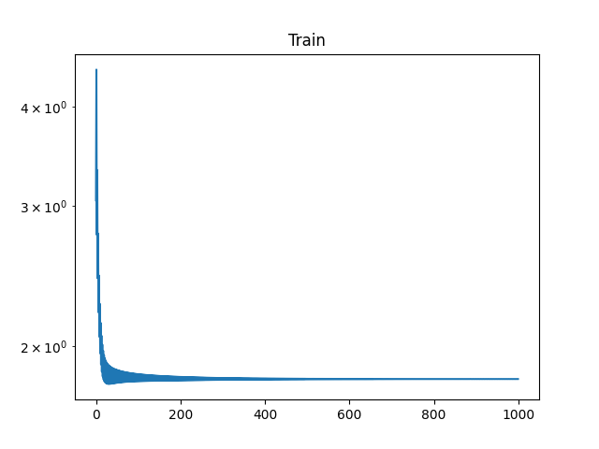

lr=0.1, regularization coefficient=1
More stable but larger MSE

Slide 7
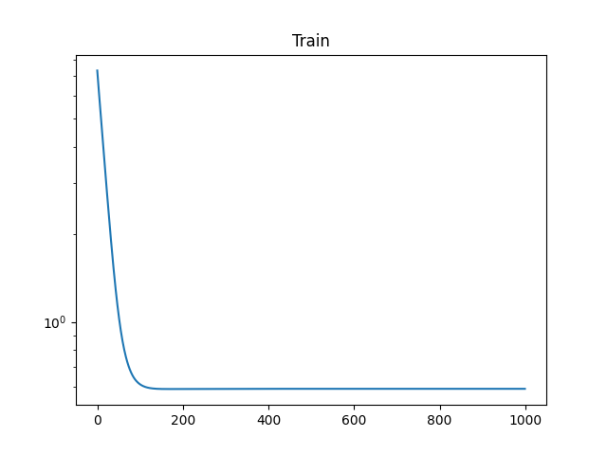
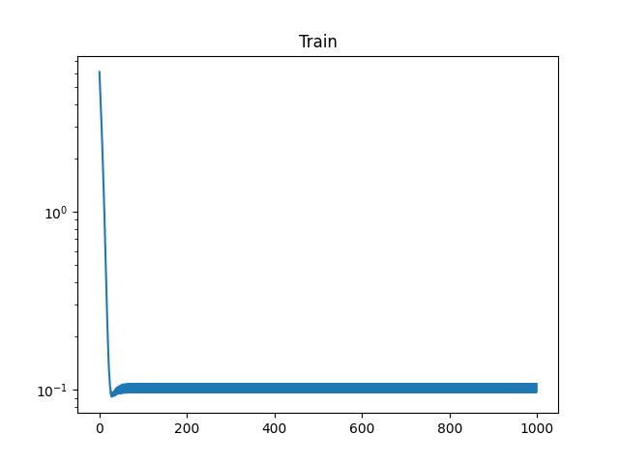


clip_ci
lr=0.11

Slide 8
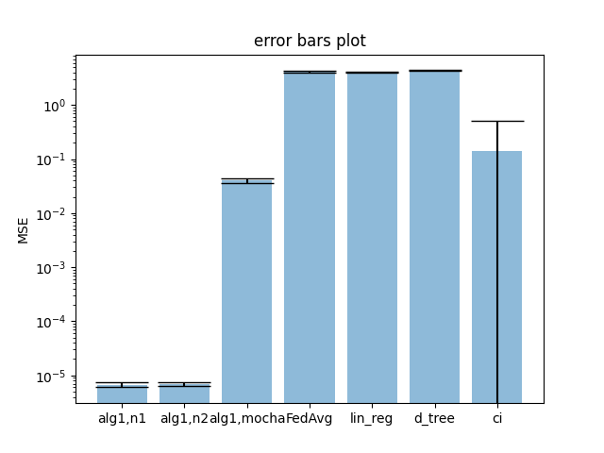
Bar plot

Slide 9
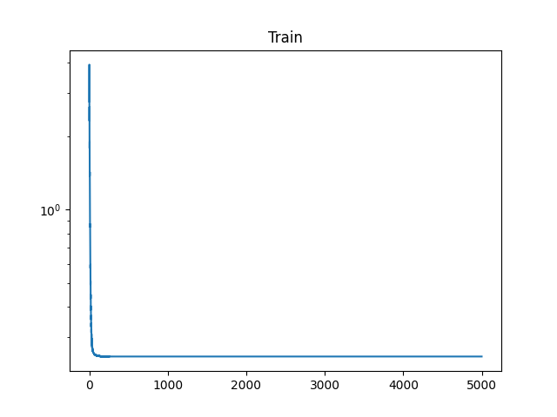
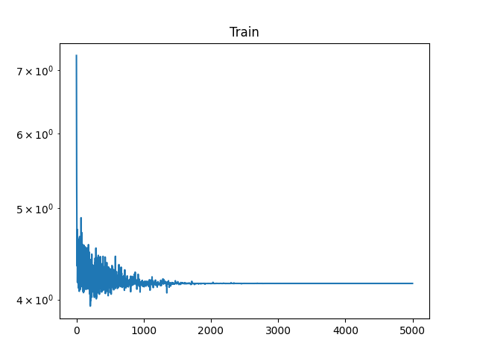
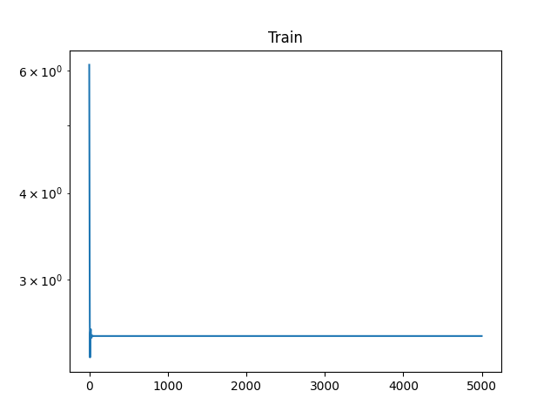



Variance Reduction after 5000 Iterations
Consensus + innovation
SAGA + CI
SVRG + CI

Slide 10
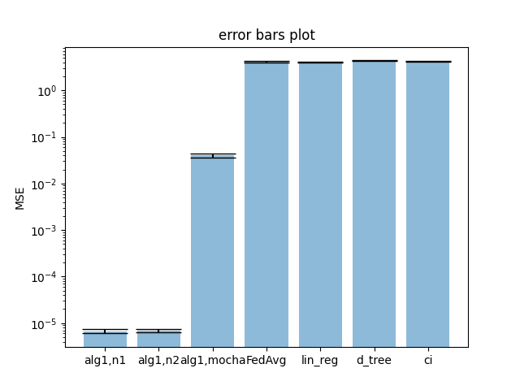
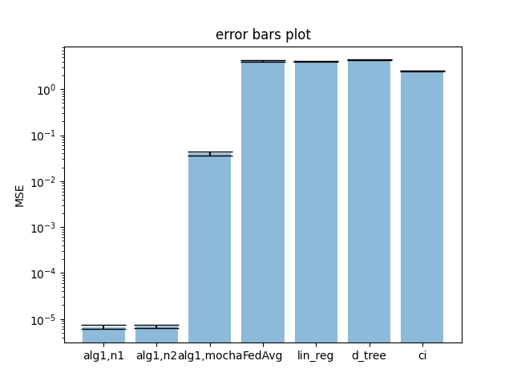
Bar plot
SAGA
SVRG

